Slide 1
Mini-Dissertation Write-up Guide
Part 02b - Open Materials Dr. Gordon Wright

Slide 2
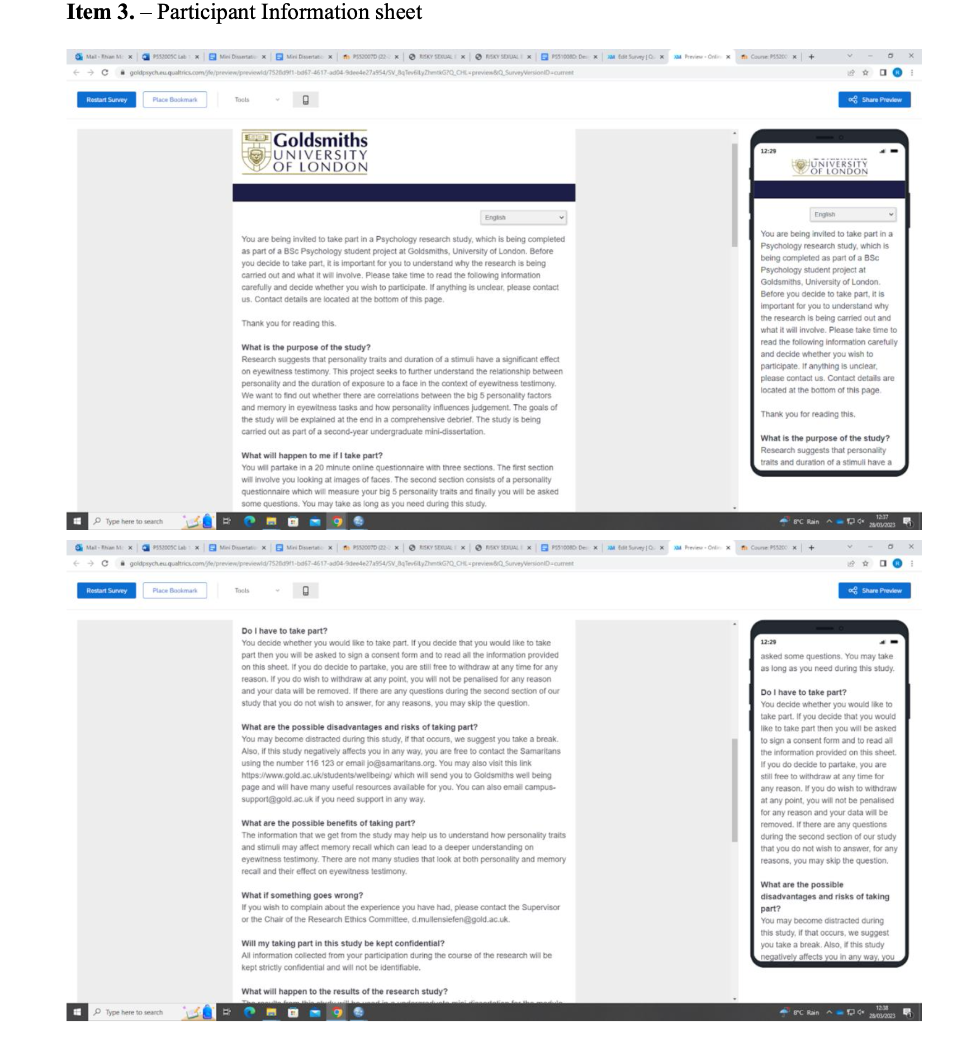
Open Materials
Learning Objectives
Understand the function of Open Materials in relation to Open Science
Review example content for Open Materials
Understand requirements for their own Mini-Dissertation
Importance of Transparency in Open Research
Enhancing Replicability and Reproducibility: Transparency in research allows other scientists to replicate studies and validate your exciting results, which is a fundamental aspect of the scientific method. Open research ensures that the data and methodologies used are accessible to others, facilitating a deeper understanding of what was done and verification of research findings.
Building Trust in Scientific Findings: Transparent practices in research foster trust among the scientific community, policymakers, and the public. When researchers openly share their methods and data, it demonstrates a commitment to honesty and integrity in their work.
Promoting Collaboration and Innovation: Open research encourages collaborative efforts, as it allows researchers from different fields and geographies to access, utilize, and build upon existing knowledge. This cross-pollination of ideas can lead to innovative solutions and advancements.
Accelerating Scientific Discovery: By making research findings and data openly available, the pace of scientific discovery can be quickened. Researchers can leverage existing work to explore new avenues of inquiry without duplicating efforts.
Advancing Educational Opportunities: Open research provides valuable resources for education and training (maybe you benefited from access to Open Resources while developing your Mini-Dissertation?), allowing students and early-career researchers to access a wealth of information and learn from real-world data and methodologies.
Role of Open Materials
Facilitating Research Transparency: Open materials, which include datasets, software, protocols, and other research tools, are central to ensuring transparency. They allow others to understand, evaluate, and replicate the research process.
Standardizing Research Practices: Open materials can help in standardizing procedures across studies, leading to more consistent and reliable research outcomes.
What Open Materials Need to Achieve
Comprehensiveness: They should provide a complete picture of the research process you employed, including informed consent and information information, tools used, and detailed methodological information.
Accessibility: Materials should be easily accessible to researchers from various fields, irrespective of their resources. Don’t share files that can’t be viewed by anyone, such as pay-for-software etc. It’s not such a huge deal for the Mini-Dissertation, but in reality, it’s counter to the point if you share, say, an SPSS file.
Usability: Open materials should be user-friendly, with clear documentation and instructions to enable effective utilization by others. They are designed to facilitate, not complicate!
Interoperability: Compatibility with different platforms and software is crucial to ensure that a wide range of researchers can use these materials. Similar to 2, but distinct.
Longevity: Ensuring that open materials are preserved for long-term use and remain accessible as technologies evolve. Again, not a big deal with a coursework submission, as they will NOT be published by me, but if you publish your Final Year Dissertation, you would want it to be long-lived!
By adhering to these principles of Openness and Collaborativeness, the scientific community can significantly benefit from open research practices, leading to more robust, innovative, and transparent scientific inquiry. And less frustration/guess-work when you come to replicate or extend work!
Tips
Your open materials are obviously going to be specific to your own research study. They obviously need to fully illustrate the wonderful things that you’ve created in the course of your mini-dissertation.
For the purposes of the mini-dissertation, you can take one of two approaches. You can either be extremely selfish and solely present the materials and tools that you used to generate the data for your individual 2x2 ANOVA, or you could view it as a mark-winning opportunity to demonstrate the wide-ranging gorgeousness of all the things that you and your group submitted.
For the purposes of the marking, the open materials is not a right or wrong exercise. Make the decision of what to include yourself. But do pay attention to what a Researcher such as myself would need to fully understand your task and to be able to replicate it. It’s fine if I can’t fully replicate something that belongs to somebody else, but I need to be able to replicate what you produced.
And do pay attention to what goes in open materials and what goes in open data. It is common that people have trouble working out where a questionnaire and its associated data might go.
I want to be able to test people with the right questionnaire measure and I would want to find the ‘questionnaire’ in Open Materials. But of course, the questionnaire results will appear in open data, where a codebook might be useful. But we’ll cover that next week.
Some examples to get ideas from
Information sheets/consent (not the easiest to read, but useful)

Slide 3
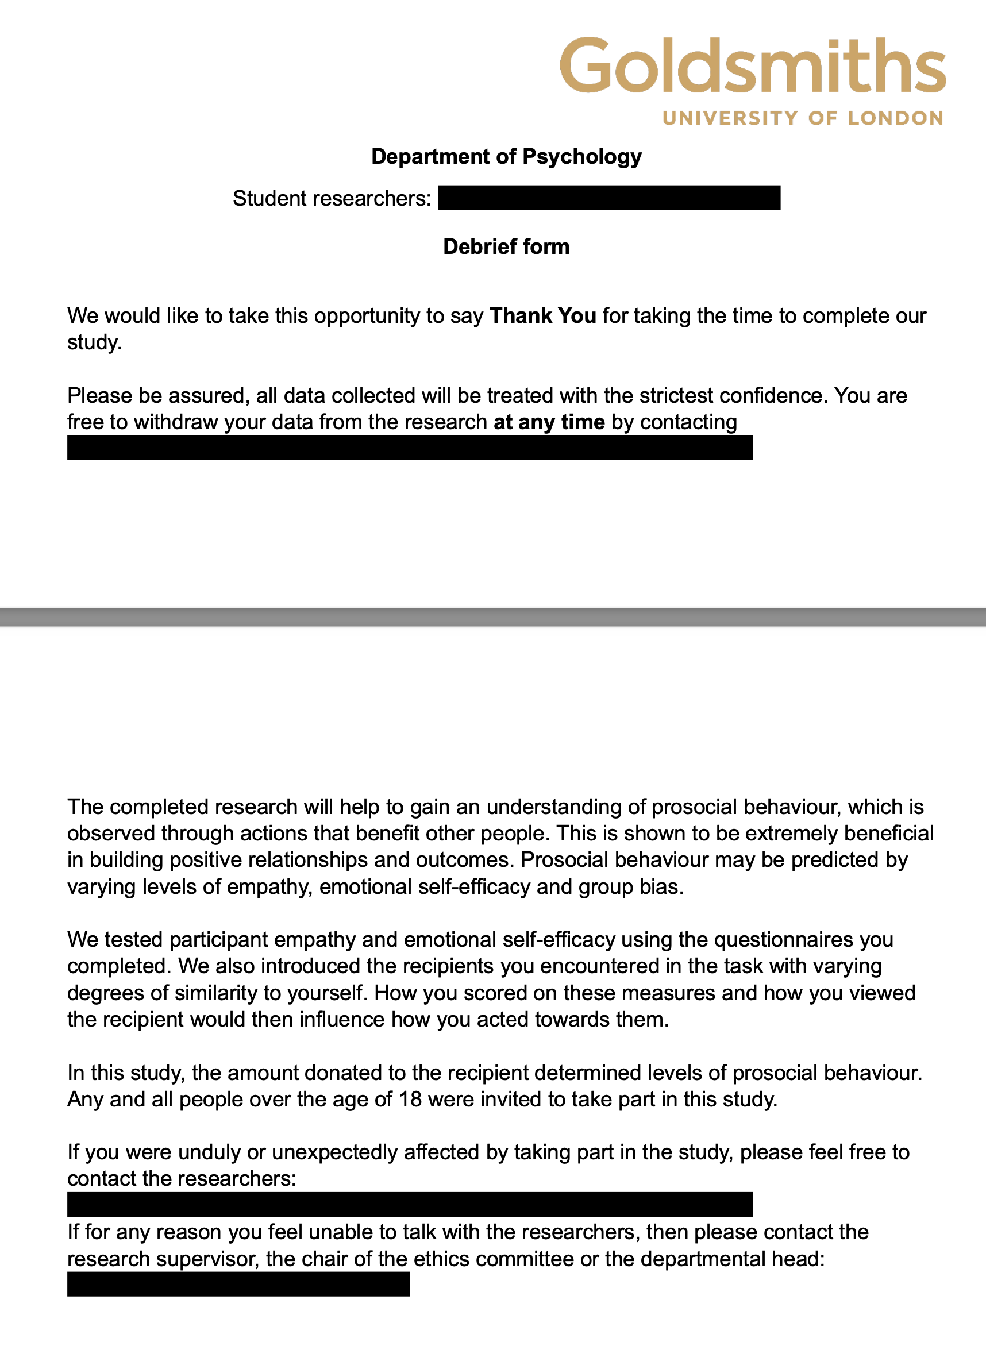
Debrief form

Slide 4
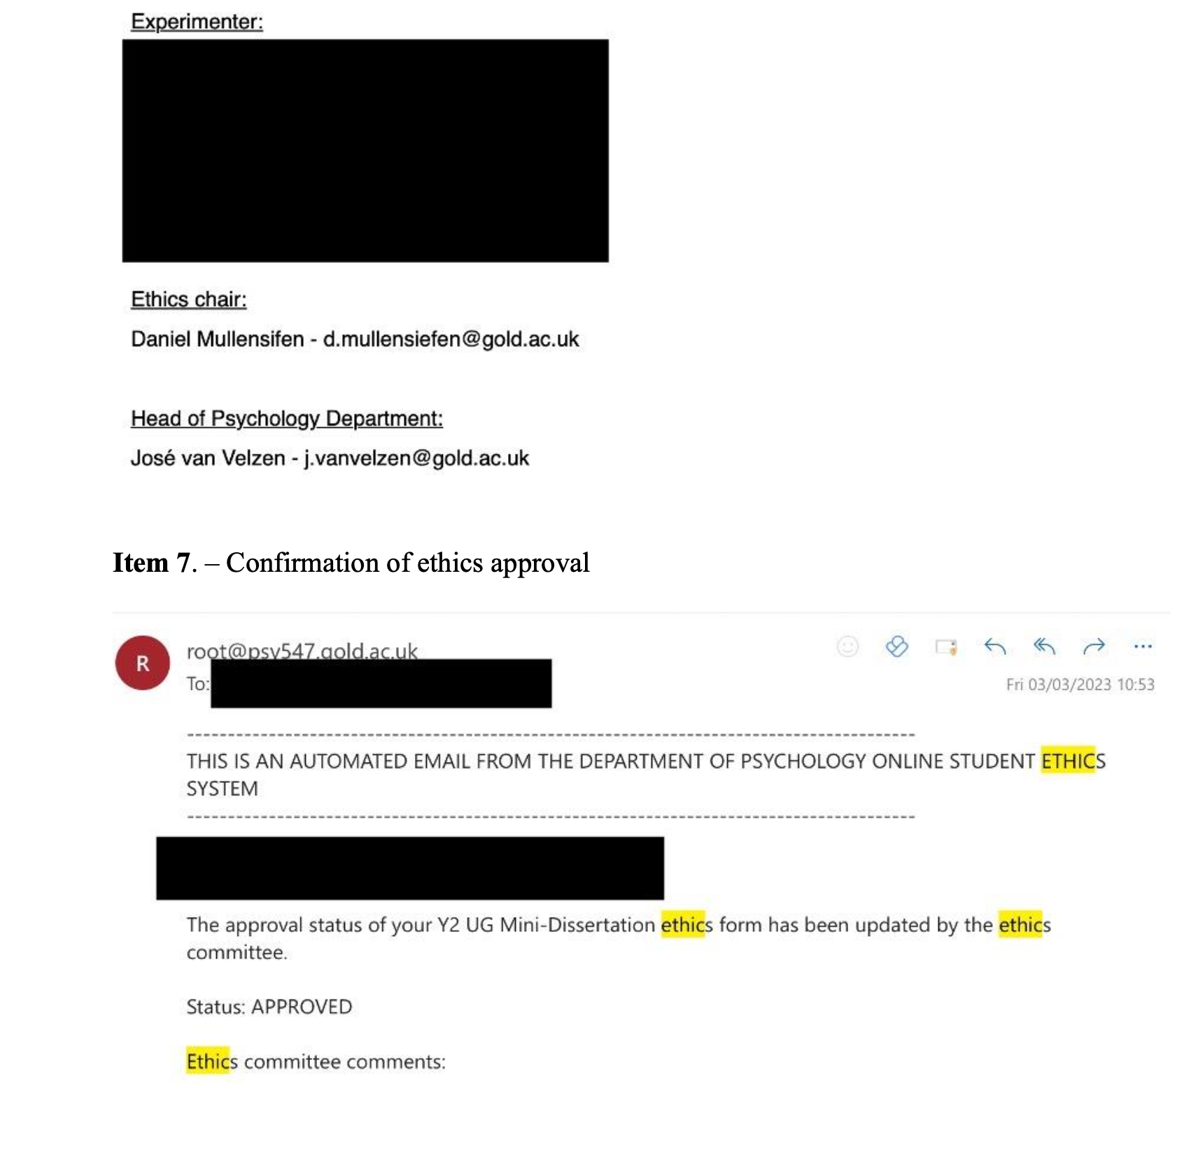
Redacted Ethics and Approval

Slide 5
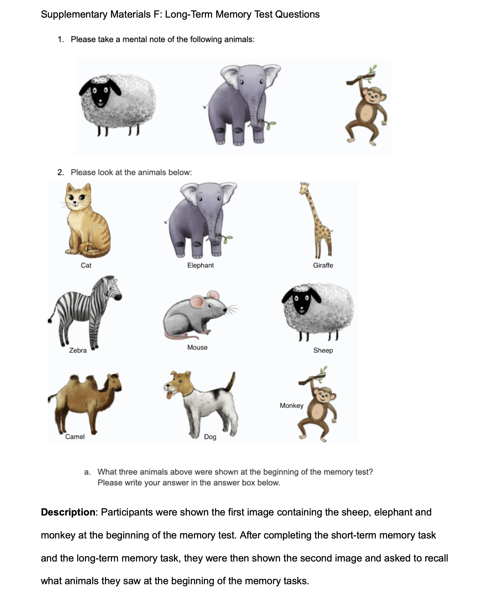
Stimulus items

Slide 6
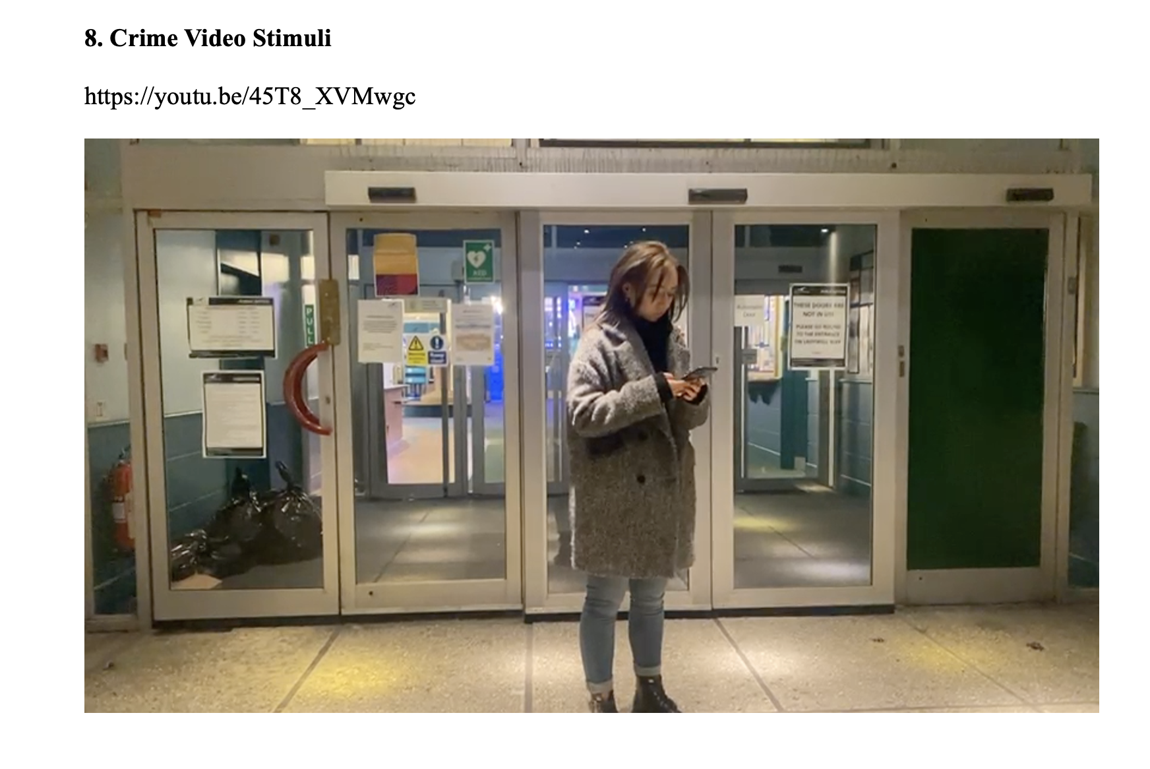
Video Stimulus Items (the link REALLY helps!)

Slide 7
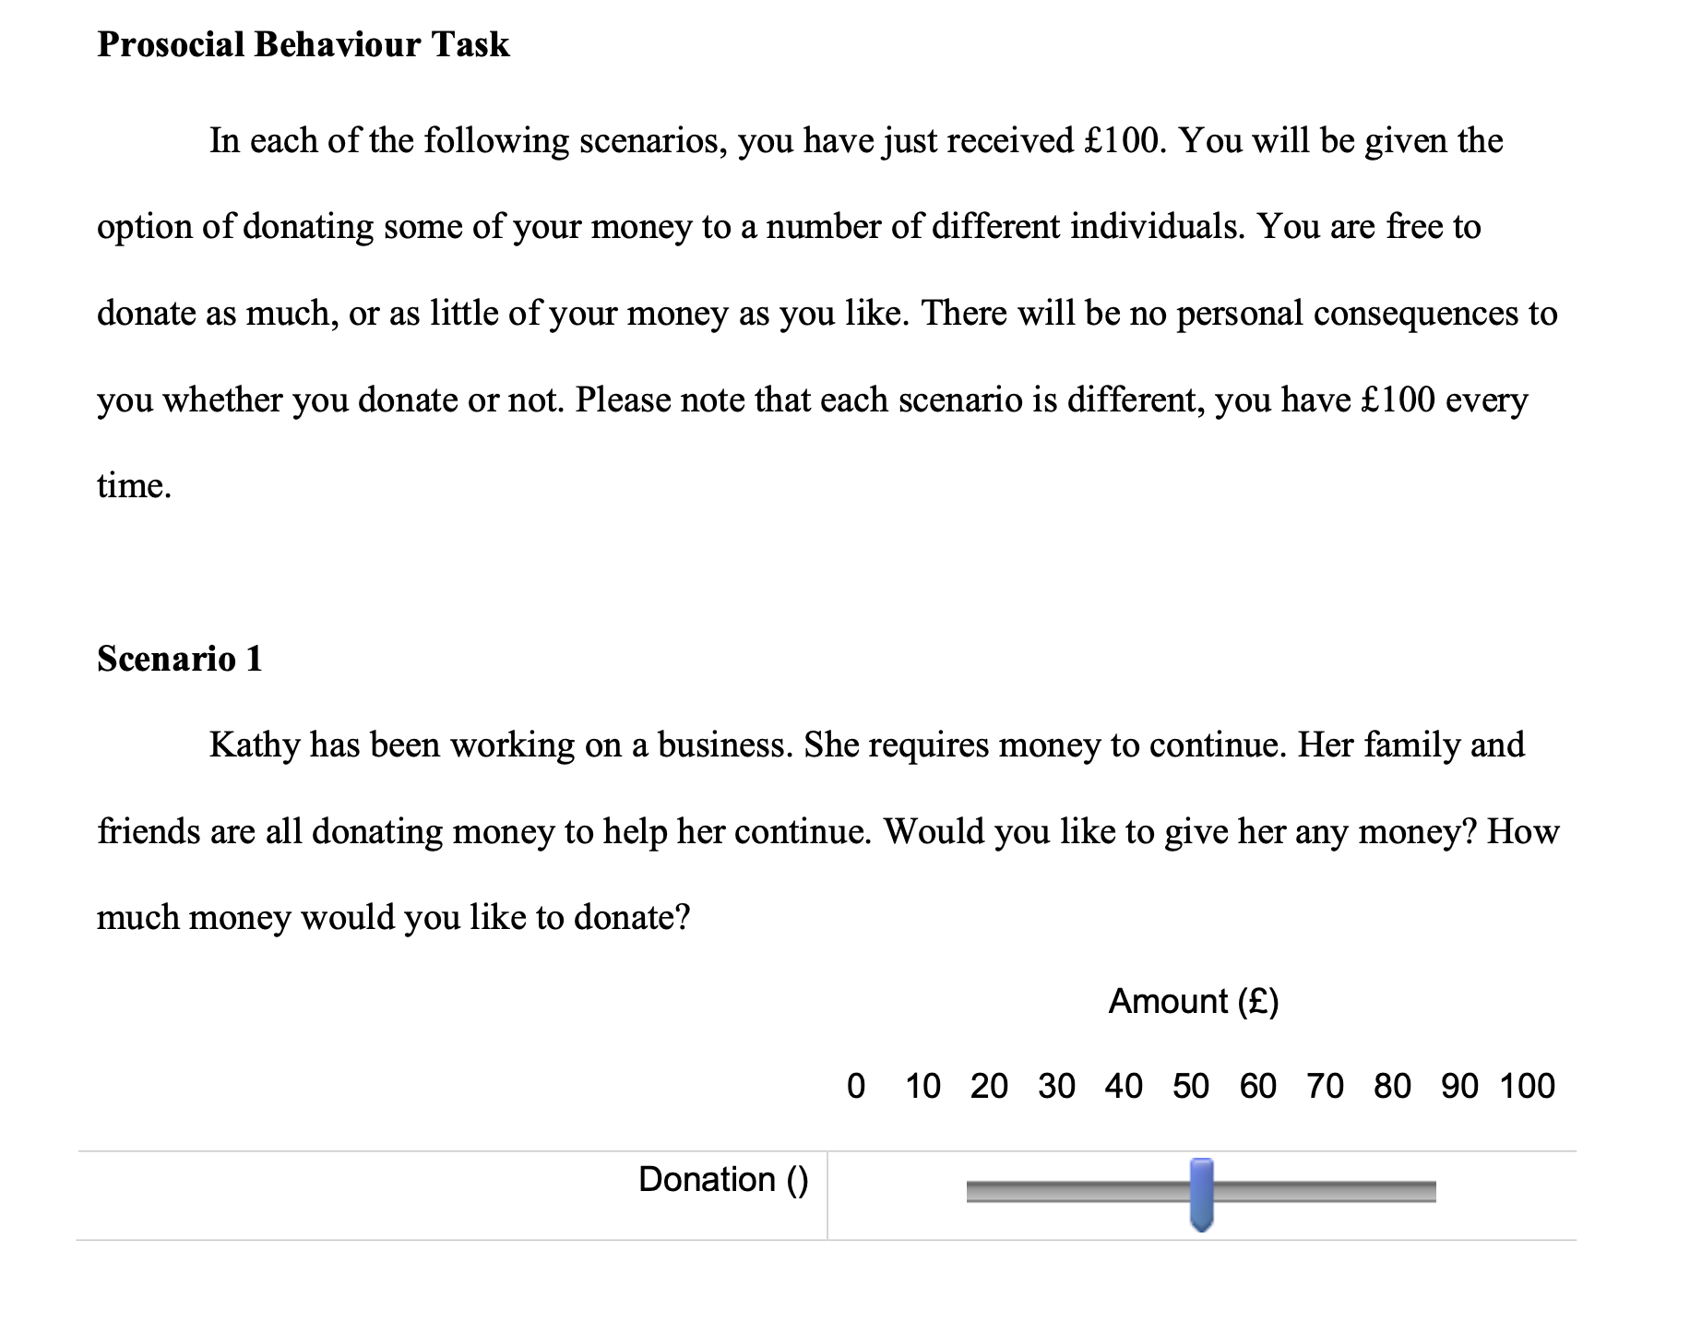
A good illustration of a behaviour measure in Qualtrics

Slide 8
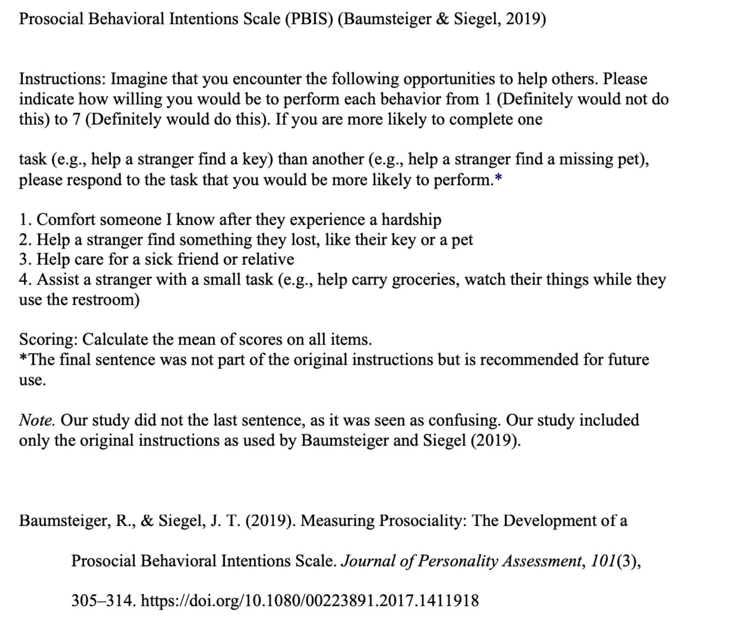
Comprehensive Questionnaire description with notes

Slide 9
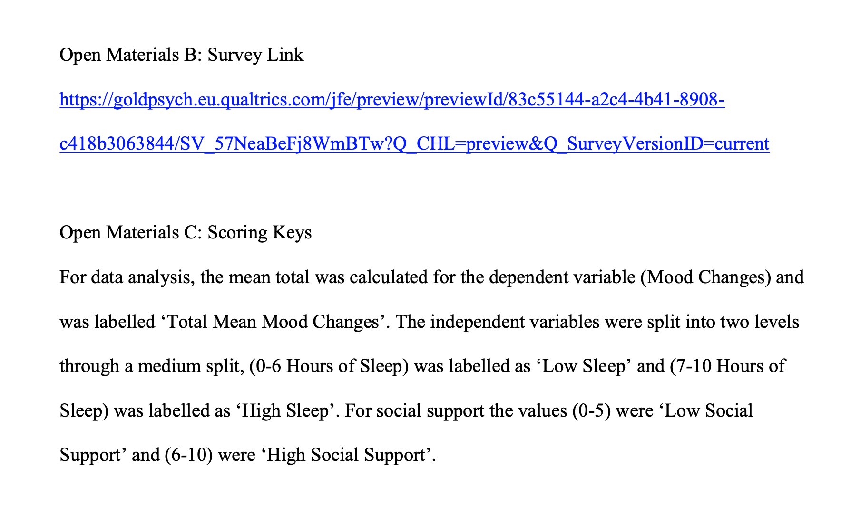
If you still have a live link, or categorised continuous IVs
n.b. Treatment of IVs, data, pre-processing steps or similar could be handled in Open Data. Just be clear!

Slide 10
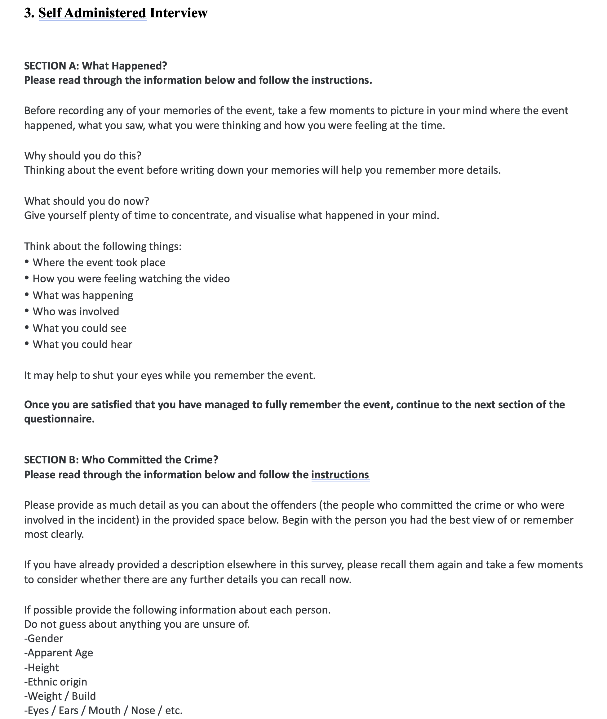
Materials for a face to face interview

Slide 11
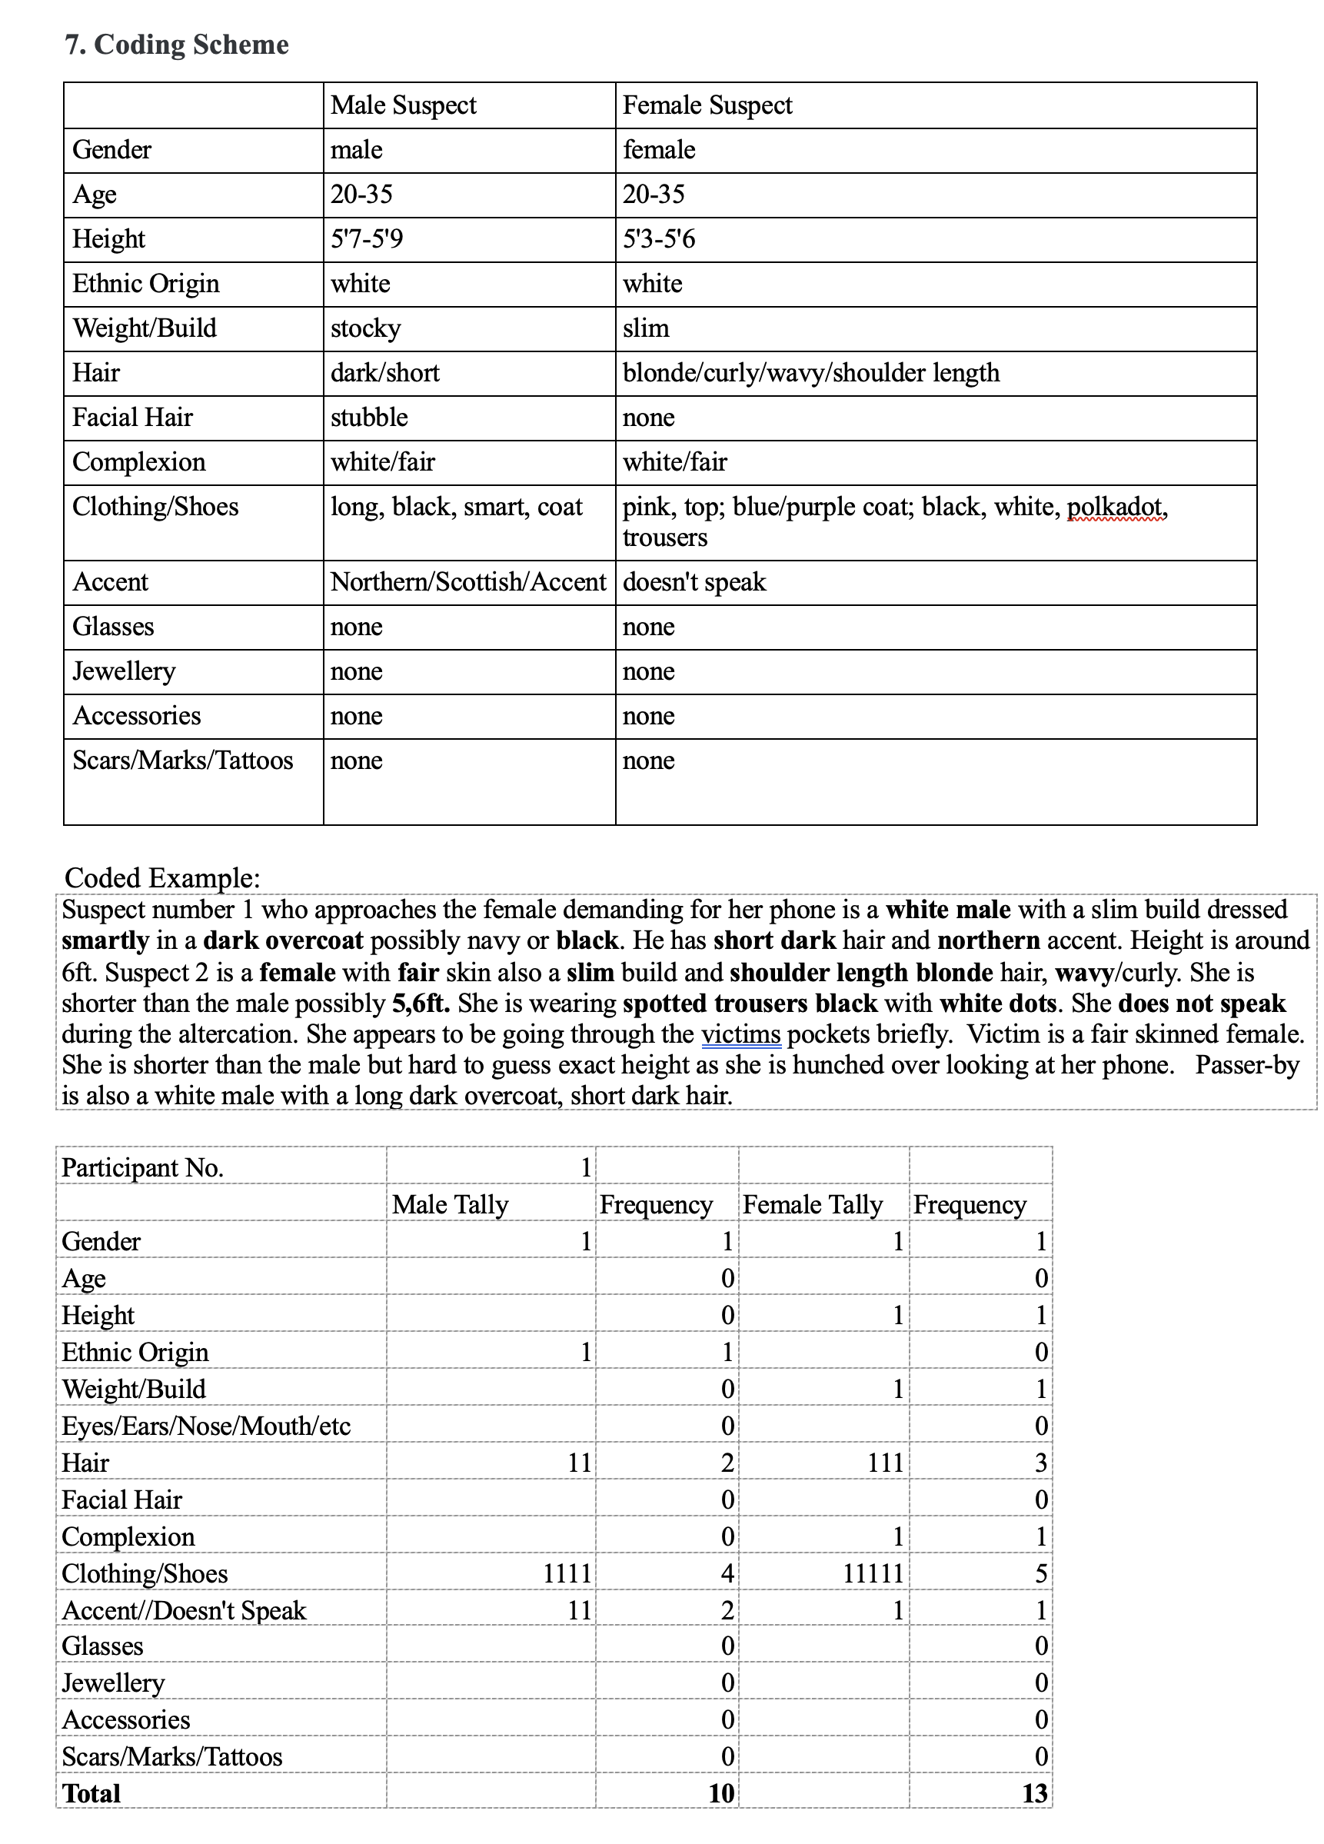
Example of interview coding scheme

Slide 12
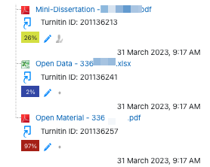
What the submission will look like in Turnitin

Slide 13
References

